Slide 1
E - AUCTION
G.YASASWINI
192110184

Slide 2
AIM : TO EVALUATE THE E-AUCTION APPLICATIONS BEHAVIOUR AND REQUIREMENTS

Slide 3
REQUIREMENTS
INTERNET CONNECTION
USERNAME(EMAIL ID OR MOBILE NUMBER)
PASSWORD
WEBSITE(https://dreembox.com)

Slide 4
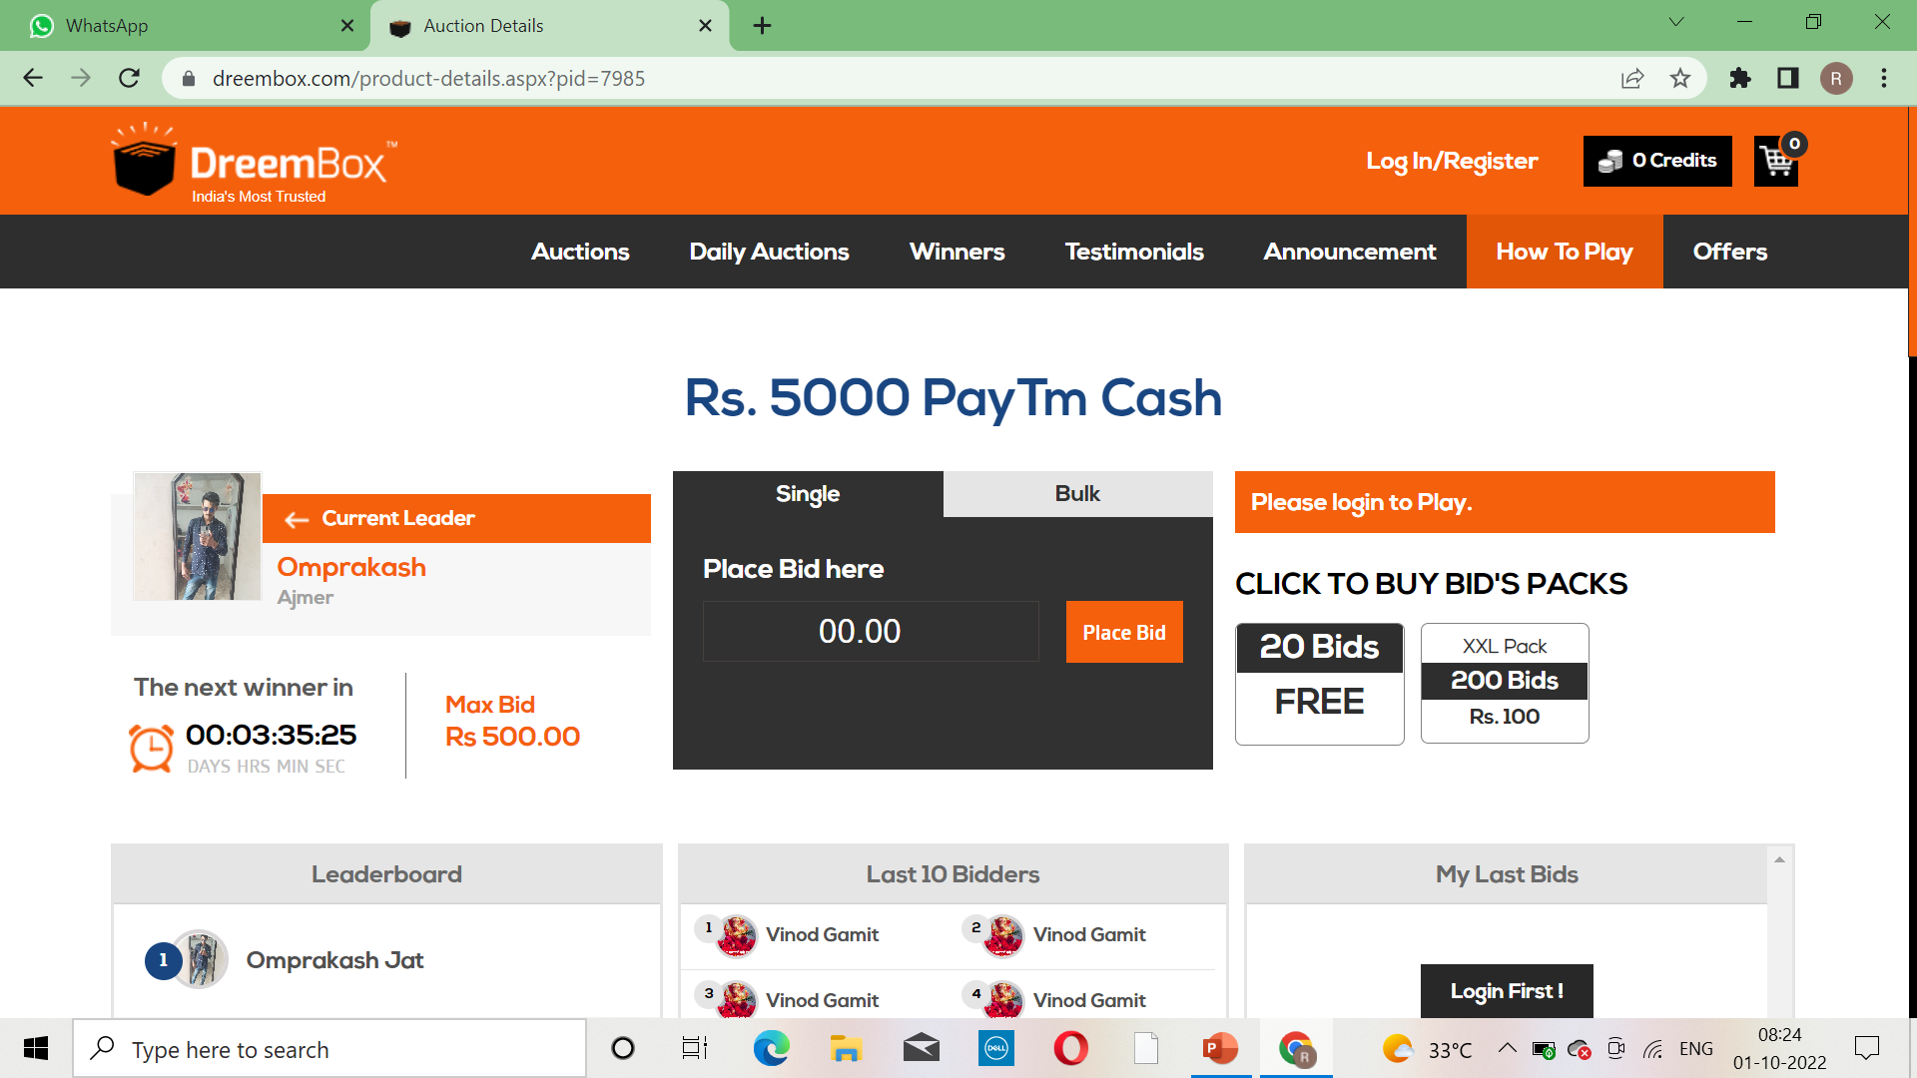
PURCHASE MODULE

Slide 5
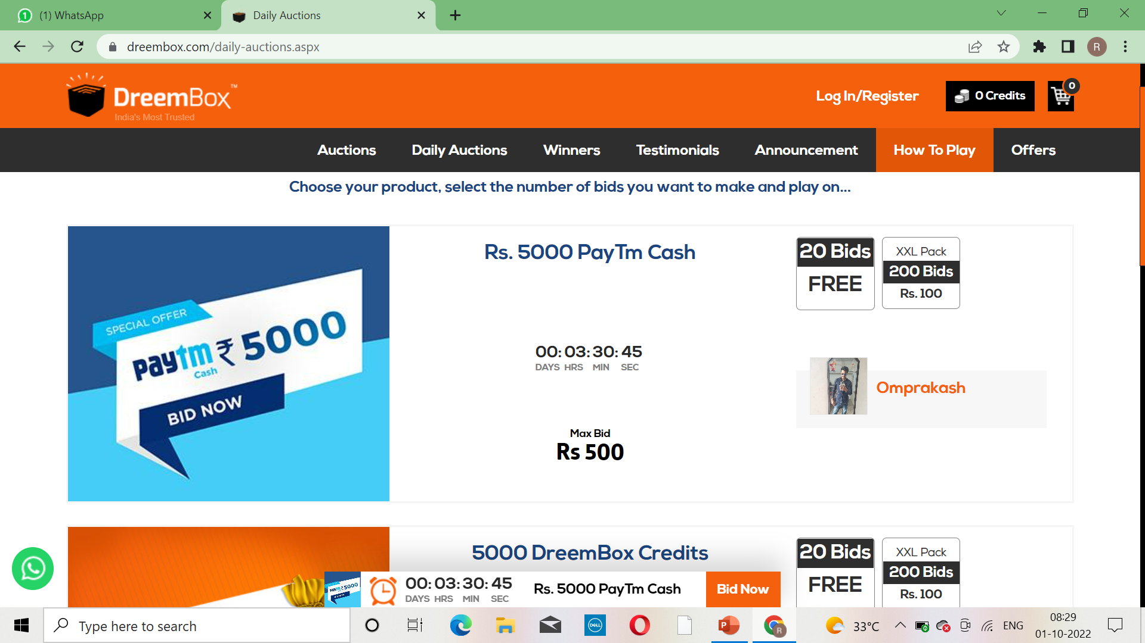
PAYMENT AND BILLING

Slide 6
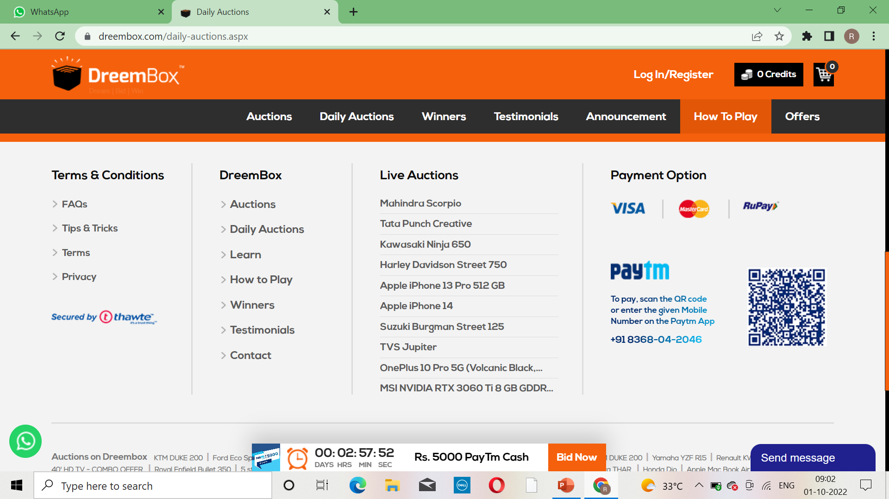

Slide 7
POSITIVE SCENARIO’S
If price is high the product is accessed
2 . User can buy the product through credit and debit card
3. User can purchase the product after enquiring about it
4. User can sell the product to another person
5. User can use the product
6. If the price is finalized with the high price then product is sold
7. User can check the payment details
8. User can access the product after payment only
9. After payment only product is accessed
10. User can add money or buy the product

Slide 8
NEGATIVE SCENARIO’S
If price is less the product is accessed
User cannot buy the product through credit and debit card
User cannot purchase the product after enquiring about it
User cannot sell the product to another person
User cannot use the product
If the price is finalized with the high price then product is not sold
User should not check the payment details
User can access the product before payment only
After payment product is not accessed
User cannot add money or cannot buy the product

Slide 9
TEST CASES
Validate If price is high the product is accessed – PASS
Validate user can buy the product through credit and debit card – PASS
Validate user can sell the product to another person – PASS
Validate after payment only product is accessed – PASS
Validate user can use the product – PASS
Validate if price is less the product is accessed – FAIL
Validate user cannot buy the product through credit and debit card – FAIL
Validate user cannot sell the product to another person – FAIL
Validate after payment product is not accessed – FAIL
Validate user cannot use the product - FAIL

Slide 10
CONCLUSION
I have navigate the paytm web application and find out the positive / pass and negative / fail test cases . This is to improve the application performance in better manner

Slide 11
THANK YOU

